Slide 1

Discrete Biomathematical Modeling of the Immune system
Brought to you by:
Sean Connolly

Slide 2
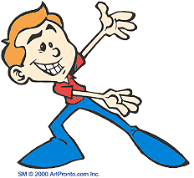
Introduction
Research questions
Goal
What misconceptions do people have about the immune system?
Viruses
Host cells
B-cells
Antibodies
Macrophages
T-cells
Helper T-cells
Computer model
Conclusion

Slide 3



Research Questions
What are the main players with the immune system and how does it really work?
How do viruses interact with cells and how do cells find and eliminate them?

Slide 4
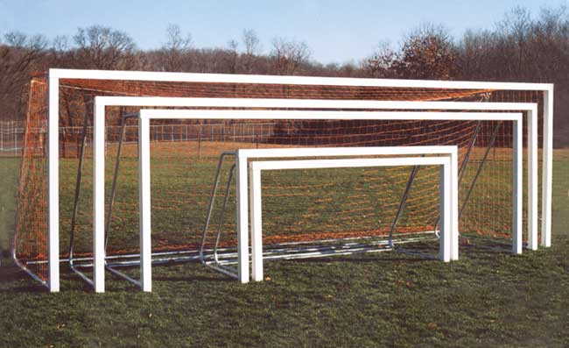
Goals
Learn some biology and biology terms
Learn the intricacies of computer programing, especially in Netlogo
Make a cool computer program that models something of a large degree of complexity
Maybe get 2 credits?

Slide 5
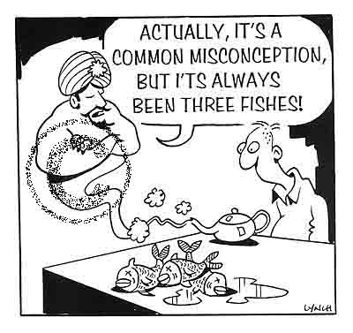
Misconceptions
The immune system consists of cells (white blood cells) that hunt down and destroy bacteria, viruses and other pathogens.
Viruses reproduce much like bacteria
Viruses can be killed with drugs
Your immune system only does stuff when you are sick

Slide 6
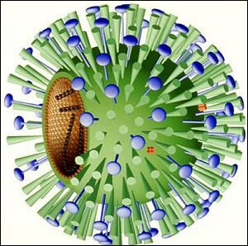
Viruses
Aren't even alive
Need a host cell to replicate
Usually infect specific types of cells
Most grow slower when hotter
Have a high mutation rate due to extreme environmental pressures. They also don't have the same mechanisms as cells to stop mutations

Slide 7
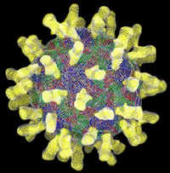
More Virus Facts
Can't be killed by drugs, but can be prevented by vaccines
20-100 times smaller than bacteria
Some can replicate in a few hours
Not all cause symptoms

Slide 8
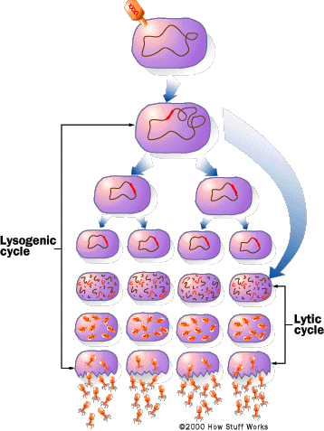
Lytic Cycle
A virus particle attaches to a host cell.
The particle releases its genetic instructions into the host cell.
The injected genetic material recruits the host cell's enzymes.
The enzymes make parts for more new virus particles.
The new particles assemble the parts into new viruses.
The new particles break free from the host cell.

Slide 9
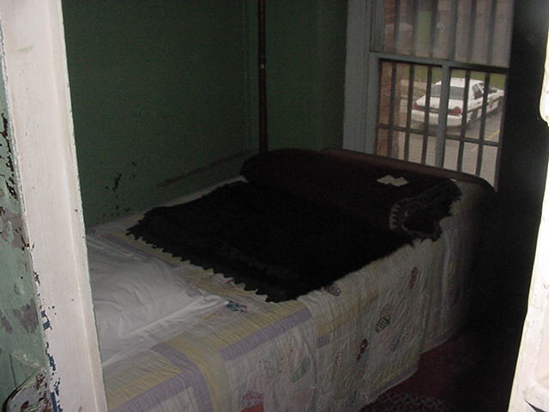
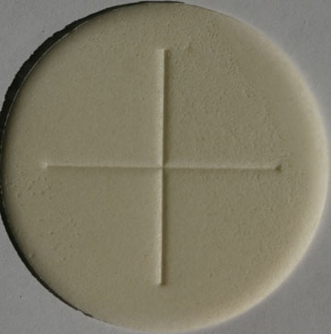
Host Cells
Just about every type of cell can be a host cell depending on the virus
Flu – attacks mucous membrane
Aids – attacks T-cells
Not all Host cells Die
They are forced to manufacture viruses against their will
Alert neighbor cells

Slide 10
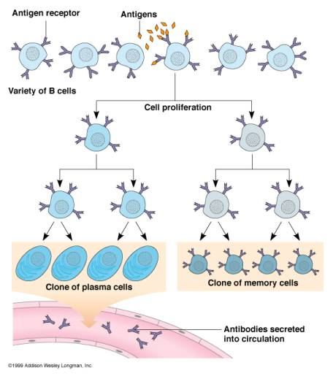
B-Cells
Create antibodies
Multiply into more antibody creating cells of the same type
Also multiply into memory cells to aid in reduction of reinfection

Slide 11
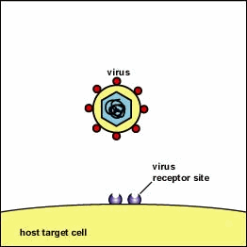
Antibodies
Neutralize antigens
Prepare antigens for ingestion by macrophages by coating their surface.

Slide 12
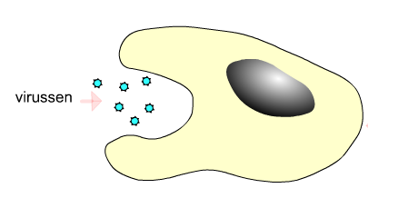
Macrophages
White blood cell that eat bacteria and other antigens
Macrophages have receptors that stick to the base of antibodies, so antigens coated with antibodies are more likely to stick to the macrophages and be ingested.

Slide 13
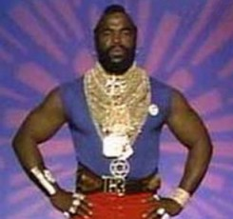
T-cells
AKA - T lymphocytes
Directly destroy cells that have specific antigens on their surface that are recognized by the killer T cells
Spot foreign antigen and KILL!
Has a specific antigen-receptor to kill specific antigens
Recruit macrophages to infection site

Slide 14
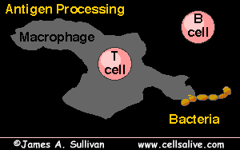
Helper T-cells
If macrophage is killing a certain type of antigen and B-cells are creating the antibody to stop it (implying there are a lot of this particular antigen) then the helper T-cell help the B-cell to make more antibodies

Slide 15
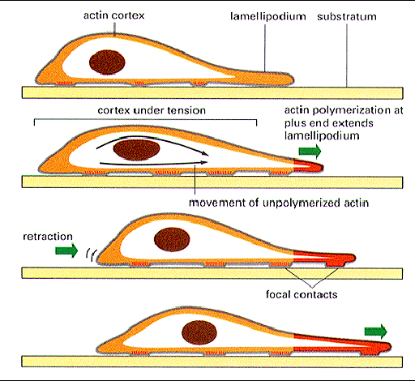
Cell Motility
Some use flagella (work like propellers
Some use cilia (work like oars)
White blood cells move by amoeboid motion (crawling)
Amoeboid motion is strong enough to move cell against current, but is slow

Slide 16
Computer Model
Assumptions:
White blood cells movement is not hindered by blood flow
Viruses kill host cells when they hatch
System consists only of antibodies, B-cells, t-cells helper T-cells and macrophages interacting
Rapture-ready compliant

Slide 17
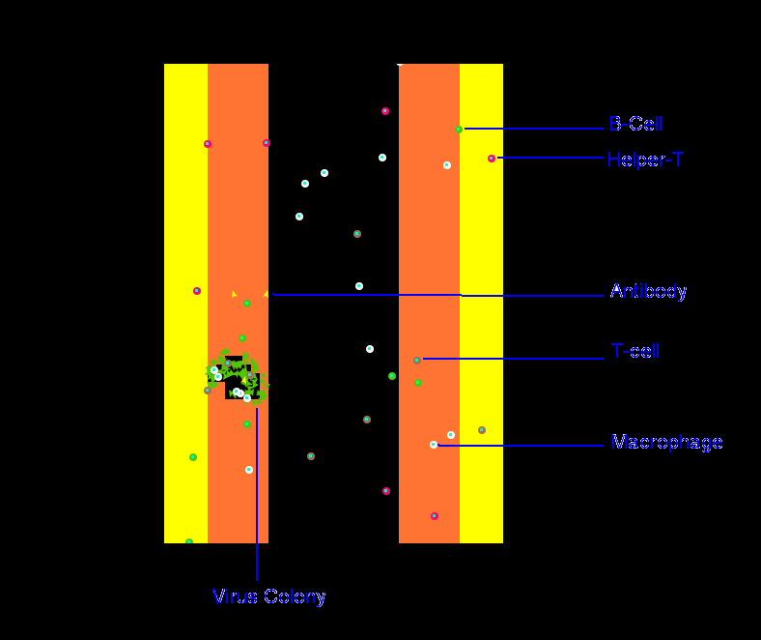

Slide 18

Conclusion
The Immune system is more complicated than you thought
I am capable of learning new things
There are several different contributers to killing viruses in the human body
Netlogo can be used for modeling the immune system if the programmer is pure skill anthropomorphized

Slide 19

Stem Cell Research Forever
Don't forget to recycle your unused embryos!

